Slide 1
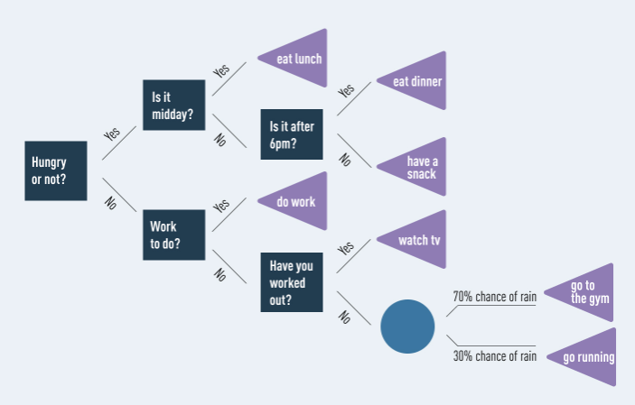
Decision Tree
In its simplest form, a decision tree is a type of flowchart that shows a clear pathway to a decision.
In terms of data analytics, it is a type of algorithm that includes conditional ‘control’ statements to classify data.
A decision tree starts at a single point (or ‘node’) which then branches (or ‘splits’) in two or more directions.

Slide 2
Contd..
For describing sequence of interrelated decisions or predicting future data trends, Decision Tree Model is used
Decision tree technique has been proven to be among the top three popular techniques of data mining
By implementing Decision Tree we could calssify the calsses based on features . Thus each tree consists of 3 nodes:
Root Node, Internal Node, Leaf or Terminal Node
A record enters the tree at the root node. The root node applies a test to determine which internal node the record will encounter next.
There are different algorithms for choosing the initial test, but the goal is always the same: To choose the test that best discriminates among the target classes.

Slide 3
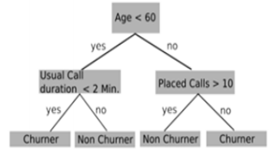
Contd..
This process is repeated until the record arrives at a leaf node. All the records that end up at a given leaf of the tree are classified the same way, and each leaf node is assigned a class label.
This is where the churn prediction model can help the business to identify such high risk customers and thereby helps in maintaining the existing customer base and increase in revenues.

Slide 4
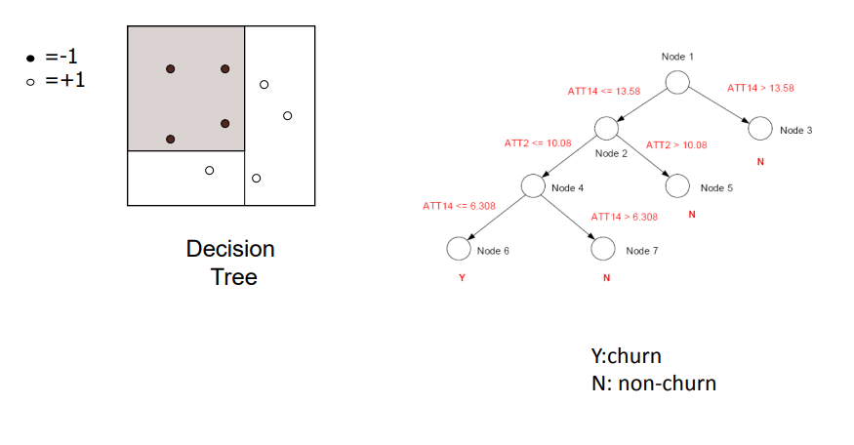
Contd..
Decision trees are the most common methods used in predicting and evaluating the classification of customer churn problems.
Decision trees are developed using the concept of divide-and conquer.

Slide 5
Contd..
To evaluate a customer’s dataset by developing a decision tree, The classification is done by altering the tree until a leaf node is attained. When evaluating a customer record a value of churner or non churner is assigned to its leaf node.
The training group can be split 70% of the dataset and aims to train the algorithms. The test group contains the remaining 30% of the dataset and is used to test the algorithms.
While training Decision Tree algorithm we should take care of optimizing the depth and the maximum number of nodes hyper-parameters
The hyper-parameters of the algorithms were optimized using K-fold cross-validation.
Beginning with oversampling and followed by duplicating the churn class to be balanced with others in the dataset.
We also used the random under sampling method, which reduces the sample size of the large class to become balanced with the second class.

Slide 6
Miscellaneous
Companies that implement a comprehensive analytics-based approach to subscriber management can reduce their churn by as much as 15%.

